Slide 1
JavaScript - Switch Case
You can use multiple if...else…if statements, as in the previous chapter, to perform a multiway branch. However, this is not always the best solution, especially when all of the branches depend on the value of a single variable.
Starting with JavaScript 1.2, you can use a switch statement which handles exactly this situation, and it does so more efficiently than repeated if...else if statements.

Slide 2
Syntax
The objective of a switch statement is to give an expression to evaluate and several different statements to execute based on the value of the expression. The interpreter checks each case against the value of the expression until a match is found. If nothing matches, a default condition will be used.

Slide 3
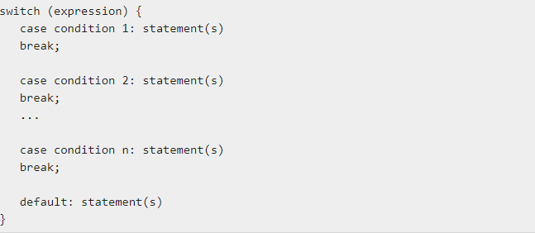

Slide 4
The break statements indicate the end of a particular case. If they were omitted, the interpreter would continue executing each statement in each of the following cases.

Slide 5
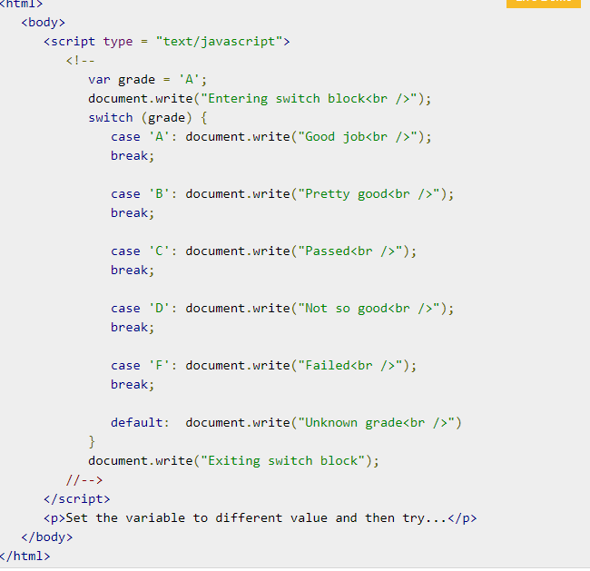

Slide 6
<!DOCTYPE html>
<html>
<head>
<title>form5</title>
</head>
<body>
<script type="text/javascript">
var grade = prompt( "enter grade", "A");
switch (grade){
case "A":
document.write("GOOD JOB");
break;
case "B":
document.write("GOOD GARADE");
break;
defualt: document.write("good grade");
}
</script>
</body>
</html>

Slide 7
<script type="text/javascript">
var grade = prompt( "enter grade", "A");
switch (grade){
case "A":
document.write("GOOD JOB");
break;
case "B":
document.write("GOOD GARADE");
break;
defualt: document.write("good grade");
}

